Slide 1
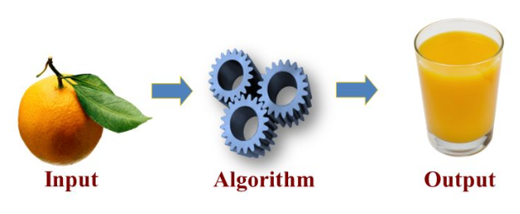
Lecture 01 Analysis of Algorithms
An algorithm is a step-by-step procedure for
solving a problem in a finite amount of time.

Slide 2
Running Time
How well an algorithm performs when input size grows?
The running time of an algorithm typically grows with the input size.
An algorithm can perform differently even if the input size is the same but have a different contents or order.

Slide 3
Best, Worst, and Average Cases
Given the same input size of n elements,
Best case occurs when an algorithm performs the minimum number of steps.
Worst case occurs when an algorithm performs the maximum number of steps.
Average case occurs when an algorithm performs the average number of steps.
Average case time is often difficult to determine.

Slide 4
Examples of Best, Worst, and Average Cases
Algorithm contains (A, e)
Input array A of n integers
Output true if e exists in A,
false otherwise
for i ← 0 to n − 1 do
if A[i] = e then
return true
return false
Best case occurs when e exists as the first element in A, the 'if' runs once only.
Worst case occurs when e does not exist in A, the 'if' runs n times.
Average case occurs when e exists in the middle of A, the 'if' runs about n/2 times.
// Java
boolean contains (int A[], int e)
{
for (int i = 0; i < A.length, i++)
if (A[i] == e)
return true;
return false;
}

Slide 5
Worst Case
We generally focus on the worst-case running time
Easier to analyze
We can estimate the maximum time for the algorithm to finish, which is crucial to applications such as games, finance and robotics

Slide 6
Running Time Analysis
2 techniques:
Experimental Studies
Theoretical Analysis

Slide 7
Experimental Studies
Write a program implementing the algorithm
Run the program with inputs of varying size and composition
Use programming language’s time method to get an accurate measure of the actual running time
Plot the results

Slide 8
Limitations of Experiments
No hardware to process huge amount of inputs
Difficult to find complete or sufficient inputs to produce indicative results
Difficult to find the same hardware and software to compare algorithms in a fair manner

Slide 9
Theoretical Analysis
Uses pseudocode instead of an implementation
Characterizes running time as a function of the input size, n.
Advantages:
Takes into account all possible inputs
Allows us to evaluate the speed of an algorithm independent of the hardware/software

Slide 10
Pseudocode
Algorithm arrayMax(A, n)
Input array A of n integers
Output maximum element of A
currentMax ← A[0]
for i ← 1 to n − 1 do
if A[i] > currentMax then
currentMax ← A[i]
return currentMax
High-level description of an algorithm
Less detailed than a programming language
More than one way to write a pseudocode code
Example: find max element of an array
Algorithm arrayMax(A, n)
Input: array A of n integers
Output: maximum element of A
currentMax = A[0]
for i = 1 to n - 1
if A[i] > currentMax
currentMax = A[i]
return currentMax

Slide 11
Primitive Operations
Basic computations performed by an algorithm
Identifiable in pseudocode
Largely independent from the programming language
Exact definition not important (we will see why later)
Assumed to take a constant amount of time
Examples:
Performing an arithmetic ops
Assigning a value to a variable
Indexing into an array
Calling a method
Returning from a method
Comparing 2 variables

Slide 12
Counting Primitive Operations
We determine the maximum number of primitive operations executed by an algorithm (worst case), as a function of the input size
This way of counting primitive operations in detail is for illustration only. Don't count in this way
Algorithm arrayMax(A, n)
# operations
currentMax ← A[0] 2
for i ← 1 to n − 1 do 1 + n
if A[i] > currentMax then 2(n − 1)
currentMax ← A[i] 2(n − 1)
{ increment counter i } 2(n − 1)
return currentMax 1
Total = 7n − 2

Slide 13
Counting Primitive Operations (cont.)
C++/Java version of arrayMax algorithm
int arrayMax (int A[], int n) { # operations
int currentMax = A[0]; 2
for (int i=1; 1
i < n; n
i++) 2(n − 1)
if (A[i] > currentMax) 2(n − 1)
currentMax = A[i]; 2(n − 1)
return currentMax 1
} Total = 7n − 2

Slide 14
Estimating Running Time
In the worst case, arrayMax executes 7n − 2 primitive operations whereby the ‘if’ loop is always true.
In the best case, arrayMax executes 5n primitive operations whereby the ‘if’ loop is always false.
Let T(n) be worst-case time of arrayMax. Then T(n) = 7n − 2
Next, we will see why we don't have to count in detail the primitive operations.

Slide 15
Growth Rate of Running Time
Fact: Changing the hardware/software environment
Affects T(n) by a constant factor, but
Does not alter the growth rate of T(n)
n, 10n and 100n grow at the same rate

Slide 16
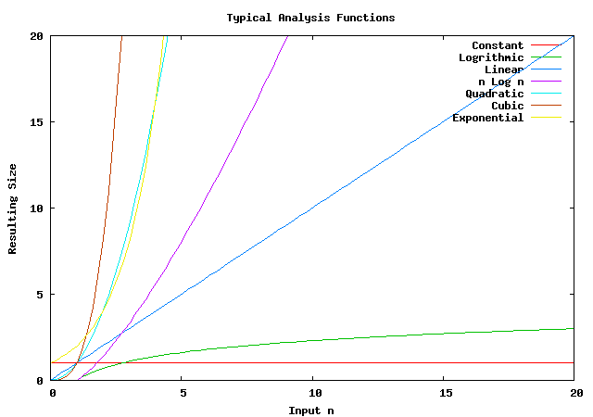
Growth Rates of Functions
From lowest to highest:
Constant ≈ 1
Logarithmic ≈ log n
Linear ≈ n
N-Log-N ≈ n log n
Quadratic ≈ n²
Cubic ≈ n³
Exponential ≈ 2^{n}

Slide 17
Big-Oh Notation (§1.2)
Given functions f(n) and g(n), we say that f(n) is O(g(n)) if there are positive constants c and n₀ such that
f(n) ≤ cg(n) for n ≥ n₀
Example: 2n + 10 is O(n)
2n + 10 ≤ cn
(c − 2) n ≥ 10
n ≥ 10/(c − 2)
Pick c = 3 and n₀ = 10

Slide 18
Big-Oh Example
Example: n² is not O(n)
n² ≤ cn
n ≤ c
The above inequality cannot be satisfied since c must be a constant

Slide 19
Big-Oh and Growth Rate
The big-Oh notation gives an upper bound on the growth rate of a function
The statement “f(n) is O(g(n))” means that the growth rate of f(n) is no more than the growth rate of g(n)
 | f(n) is O(g(n)) | g(n) is O(f(n))
g(n) grows more | Yes | No
f(n) grows more | No | Yes
Same growth | Yes | Yes

Slide 20
Big-Oh Rules
If is f(n) a polynomial of degree d, then f(n) is O(n^{d}), i.e.,
Drop lower-order terms
Drop constant factors
Use the smallest possible class of functions
Say “2n is O(n)” instead of “2n is O(n²)”
Use the simplest expression of the class
Say “3n + 5 is O(n)” instead of “3n + 5 is O(3n)”

Slide 21
Asymptotic Algorithm Analysis
Determines running time in big-Oh notation
To perform the asymptotic analysis
We find the worst-case number of primitive operations executed as a function of the input size
We express this function with big-Oh notation
Example:
We determine that algorithm arrayMax executes at most 7n − 2 primitive operations
We say that algorithm arrayMax “runs in O(n) time”
Since constant factors and lower-order terms are eventually dropped anyhow, we can disregard them when counting primitive operations

Slide 22
Asymptotic Algorithm Analysis
Since constant factors and lower-order terms are eventually dropped anyhow, we can disregard them when counting primitive operations
Algorithm arrayMax(A, n)
# operations
currentMax ← A[0] 1
for i ← 1 to n − 1 do n
if A[i] > currentMax then n
currentMax ← A[i] n
{ increment counter i } n
return currentMax 1
Total = O(n)

Slide 23
The Importance of Asymptotics
An algorithm with an asymptotically fast running time (low growth rate) can process more inputs than an algorithm with an asymptotically slow running time (high growth rate)
Maximum Problem Size (n)
Running Time | 1 second | 1 minute | 1 hour
O(n) | 2,500 | 150,000 | 9,000,000
O(nlog n) | 4,096 | 166,666 | 7,826,087
O(n²⁾ | 707 | 5,477 | 42,426
O(n⁴⁾ | 31 | 88 | 244
O(2^{n)} | 19 | 25 | 31

Slide 24
Computing Prefix Sums
Another example: prefix sums
The i-th prefix sum of an array X is sum of the first (i + 1) elements of X:
A[i] = (X[0] + X[1] + … + X[i])
We will compare 2 algorithms with different running time for computing prefix sums
prefixSum1 runs in O(n²)
prefixSum2 runs in O(n)
Which one runs faster?

Slide 25
PrefixSums1 (Quadratic)
The following algorithm computes prefix averages in quadratic time n ²
Algorithm prefixSum1 (X, n)
Input array X of n integers
Output array A of prefix sums of X #operations
A ← new array of n integers 1
for i ← 0 to n − 1 do n
s ← X[0] n
for j ← 1 to i do 1+2+…+(n−1) ≈ n²
s ← s + X[j] 1+2+…+(n−1) ≈ n²
A[i] ← s n
return A 1
T(n) = O(n²)

Slide 26
Arithmetic Progression
The sum of the first n integers (1 + 2 + …+ n) is n(n + 1) / 2
There is a simple visual proof of this fact
Thus, algorithm prefixSum1 runs in O(n²) time

Slide 27
PrefixSum2 (Linear)
The following algorithm computes prefix sums in linear time n by using the previous sum
Algorithm prefixSums2 (X, n)
Input array X of n integers
Output array A of prefix averages of X #operations
A ← new array of n integers 1
s ← 0 1
for i ← 0 to n − 1 do n
s ← s + X[i] n
A[i] ← s n
return A 1
T(n) = O(n)

Slide 28
Intuition for Asymptotic Notation
Big-Oh
f(n) is O(g(n)) if f(n) is asymptotically less than or equal to g(n)
big-Omega
f(n) is Ω(g(n)) if f(n) is asymptotically greater than or equal to g(n)
big-Theta
f(n) is Θ(g(n)) if f(n) is asymptotically equal to g(n)
little-oh
f(n) is o(g(n)) if f(n) is asymptotically strictly less than g(n)
little-omega
f(n) is ω(g(n)) if is asymptotically strictly greater than g(n)

Slide 29
Example Uses of the Relatives of Big-Oh
5n² is Ω(n²)
5n² is Ω(n)
5n² is ω(n)

Slide 30
Time Complexity, T(n)
Time complexity, T(n), refers to the use of asymptotic notation (O, Ω, Θ, o, ω) in denoting running time
If 2 algorithms accomplish the same task with different time complexities:
One is faster than another
As input n increases further, the performance difference becomes more obvious
Faster algorithm is generally preferred

Slide 31
Time Complexity Comparison
A fast algorithm has a low time complexity, while a slow algorithm has a high time complexity.
Ranking of selected time complexities:
Constant ≈ 1 (lowest T(n), fastest speed)
Logarithmic ≈ log n
Linear ≈ n
N-Log-N ≈ n log n
Quadratic ≈ n²
Cubic ≈ n³
Exponential ≈ 2^{n} (highest T(n), slowest speed)

